Slide 1
ACE Engineering College
Data intelligence and AI

Slide 2
Day 8: Prompt Engineering & Intelligent App Integration
Prompt Engineering is the process of designing effective instructions for AI models to produce accurate, relevant, and structured outputs. It is essential when integrating AI into real-world applications.
1. Foundations of Prompt Design
A well-designed prompt contains:
A. System Role
Defines the AI's behavior and expertise.
Example:
You are an expert customer support assistant. Answer politely and accurately.

Slide 3
B. Context Information
Provides background information for better responses.
Example:
Customer Name: John Order ID: 12345 Product: Wireless Mouse Issue: Not charging

Slide 4
C. Task Instructions
Clearly specify what the model should do.
Example:
Analyze the issue and suggest troubleshooting steps.
D. Output Format
Define how the response should appear.
Example:
Return: 1. Problem Summary 2. Possible Causes 3. Recommended Solution

Slide 5
Complete Prompt Example
System:
You are an IT support expert. Context: Employee Name: Rahul Laptop Model: Dell Inspiron 15 Issue: Laptop overheating Task: Provide troubleshooting guidance. Output Format: - Problem Summary - Causes - Solutions

Slide 6
Expected Output
Problem Summary:
Laptop overheating. Causes: 1. Dust accumulation. 2. High CPU usage. 3. Blocked ventilation. Solutions: 1. Clean air vents. 2. Close unnecessary applications. 3. Use a cooling pad.

Slide 7
2. Context Injection Frameworks
Context Injection allows applications to provide real-time data from databases, APIs, or documents to the AI.
Why Context Injection?
Without context:
What is the status of order 12345?
AI doesn't know the answer.
With context:
Order 12345: Customer: John Status: Shipped Tracking: TRK789654

Slide 8
Database Context Injection Workflow
User Query ↓ Backend Fetches Data ↓ Database/API ↓ Prompt Construction ↓ LLM ↓ Response

Slide 9
Example
User Question
Where is my order?
Database Result
{ "order_id": "12345", "customer": "John", "status": "Out for Delivery", "expected_delivery": "2025-08-10" }

Slide 10
Prompt Sent to AI
You are a customer support assistant. Order Information: Order ID: 12345 Status: Out for Delivery Expected Delivery: 2025-08-10 Answer the customer's question.
AI Response
Your order (12345) is currently out for delivery and is expected to arrive on 2025-08-10.

Slide 11
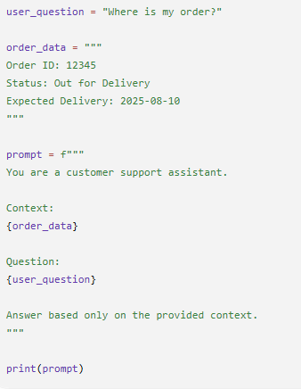
Python Example

Slide 12
3. Structural JSON Output Enforcement
Applications often require machine-readable outputs rather than plain text.
JSON output makes AI responses easy to process programmatically.
Unstructured Response
The customer is satisfied and the priority level is low.
Harder for software to parse.

Slide 13
Structured JSON Response
{ "customer_sentiment": "positive", "priority": "low" }
Easy for applications to process.
Prompt for JSON Output
Analyze the support ticket. Return ONLY valid JSON. Format: { "issue_type": "", "priority": "", "recommended_action": "" }

Slide 14
Example Input
My internet connection has been down for 3 days.
AI Output
{ "issue_type": "Network Outage", "priority": "High", "recommended_action": "Escalate to network support team" }

Slide 15
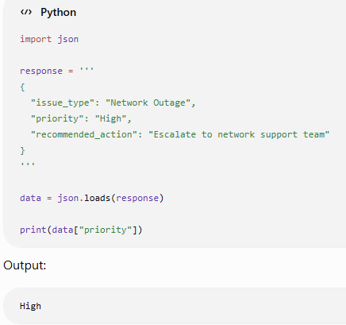
Python JSON Parsing Example

Slide 16
Best Practices for Prompt Engineering
Be Specific
❌ Bad
Tell me about Python.
✅ Good
Explain Python's OOP concepts with examples suitable for beginners.
Provide Context
❌ Bad
Analyze this.
✅ Good
Analyze the sales data and identify the top-performing product.
Define Output Structure
❌ Bad
Summarize customer feedback.
✅ Good
Return JSON: { "summary": "", "positive_points": [], "negative_points": [] }

Slide 17
Use Delimiters
Context: --- Customer purchased a laptop. Reported battery issue. --- Task: Suggest troubleshooting steps.

Slide 18
Real-World Intelligent App Integration Example
AI-Powered Job Portal
User Query:
Find suitable jobs for me.
Database Context:
{ "skills": ["Python", "Machine Learning", "SQL"], "experience": 2, "location": "Hyderabad" }
Prompt:
You are a career advisor. Candidate Profile: Skills: Python, Machine Learning, SQL Experience: 2 years Location: Hyderabad

Slide 19
Recommend 5 suitable jobs. Return JSON format: { "job_title":"", "reason":"" }
AI Output:
[ { "job_title": "Data Analyst", "reason": "Strong SQL and Python skills" }, { "job_title": "ML Engineer", "reason": "Machine Learning experience" } ]

Slide 20
Summary
Topic | Purpose
Prompt Design | Create clear instructions for AI
System Roles | Define AI behavior
Context Injection | Supply real-time database/API data
Output Formatting | Control response structure
JSON Enforcement | Produce machine-readable results
Intelligent Integration | Connect AI with applications and databases

Slide 21
Key Formula:
System Role + Context Data + Clear Task + Output Format = Reliable AI Responses

Slide 22
Project
git clone https://github.com/codingacharya/prompt-engineering.git
cd prompt-engineering
pip install streamlit pandas openai python-dotenv
streamlit run app2.py

